Slide 1
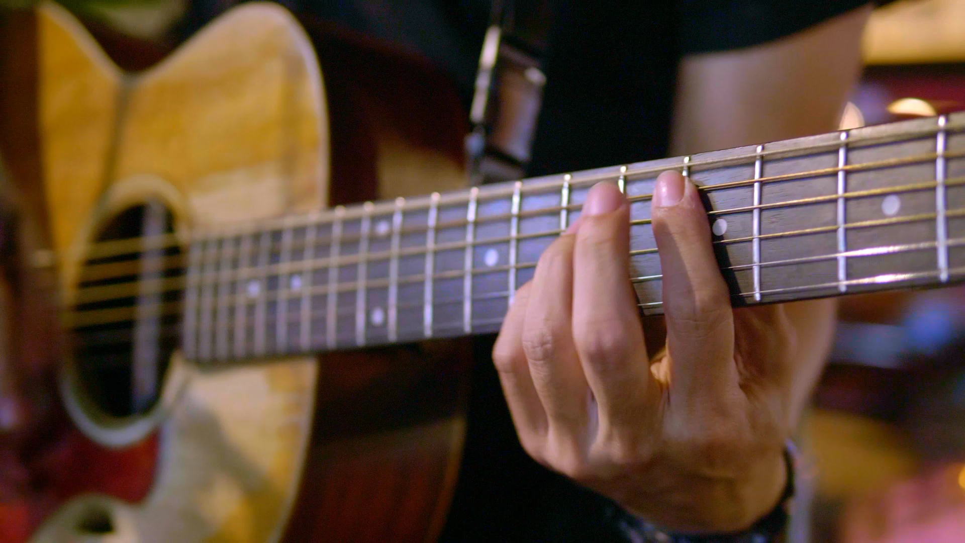
MMI 604 FINAL PROJECT
Guitarizzz-
Pluck Synth Guitar
Physical modelling of a Plucked String Synthesizer with the Karplus-Strong Algorithm in JUCE
Navaneeth Suresh Kumar
Vipul Dube

Slide 2

Introduction
Objectives
Physical modelling of a guitar string
Understanding the algorithm and midi architecture for a guitar synth in Juce.
Participant study to find the effectiveness and the user experience

Slide 3
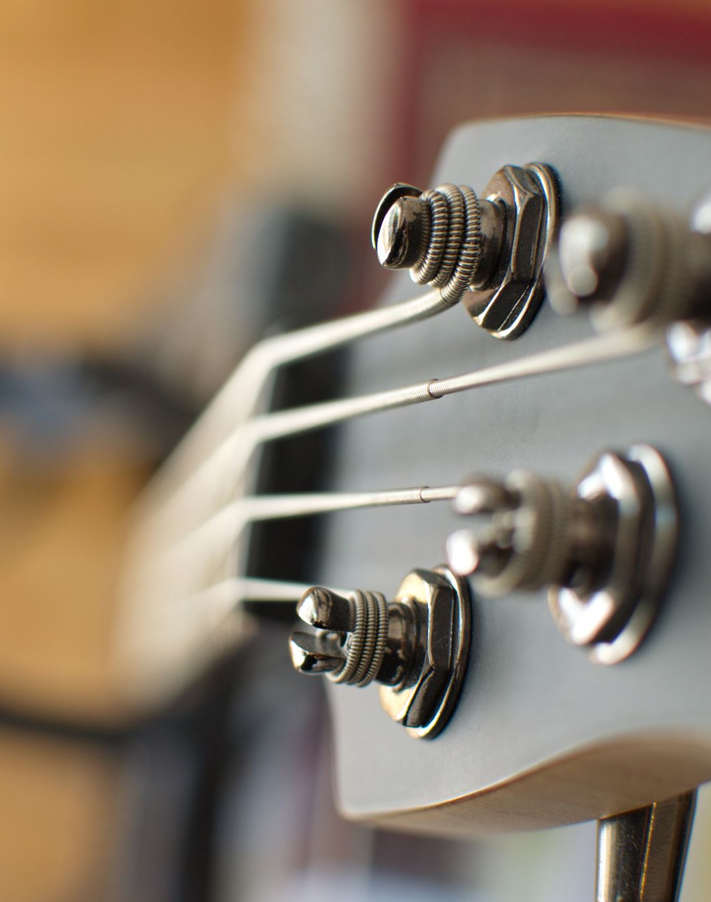
Problem Definition
Why do we need to design this synthesizer?
A lot of current synthesizers struggle to capture the true essence of plucked string sounds, lacking authenticity.
To meet the need of engineers and sound designers it is essential to create a specialized tool that would expressive and would create lifelike plucked string sounds.

Slide 4
Solution
Build a plucked String Synthesizer Using Karplus Strong algorithm in Juce Framework.
It needs to support Polyphony to play chords and Velocity sensitive to control the dynamics of the notes.
It needs to have functionalities to tweak the tone, modulate the amplitude, distortion, Delay and gain parameters to add more variation to the sound.

Slide 5





Major design blocks for this plugin
Karplus-Strong Algorithm: Our foundation was the renowned Karplus-Strong algorithm, known for its ability to replicate the vibrations and behavior of plucked strings with precision.
Decay Knob: controls the decay of the tone
Amplitude Modulation(Tremolo): Amplitude modulation is a powerful tool for sculpting evolving and dynamic sounds. It allows users to introduce amplitude change over time, giving our synthesizer an edge in creating expressive plucked string tones.
Distortion: Distortion adds character and grit to our synthesizer's output. Users can apply distortion to the plucked string sound, opening up possibilities for edgier and non-conventional timbres.
Delay: Delay Time, Feedback and Wetness control with linear interpolated indices.
Gain Control: Gain control is crucial for achieving the right balance in audio output.

Slide 6
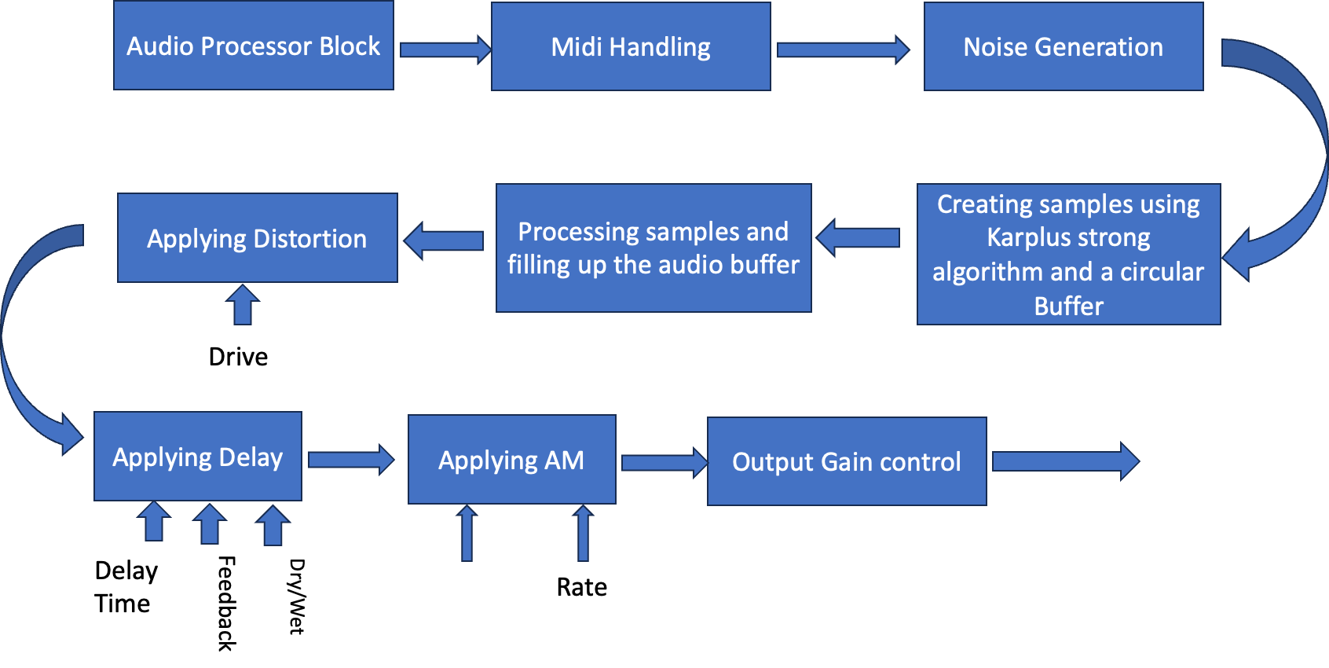
Block Diagram
Juce Audio Buffer
Depth

Slide 7
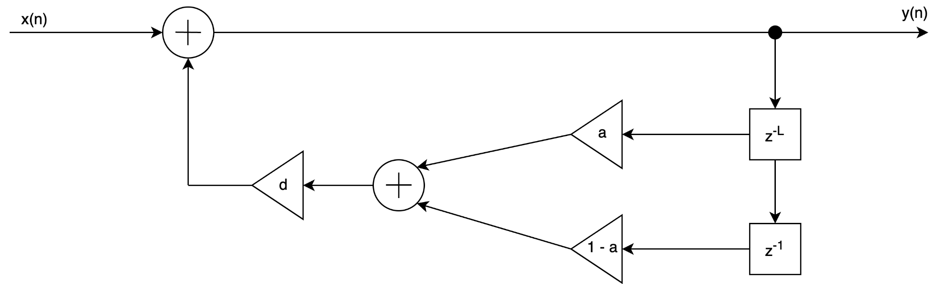
Implementing the Karplus-Strong Algorithm
Noise burst of length L = Sampling Rate/fo

Slide 8
Implementing Soft clipping distortion Using tanh()
Tanh(sample * drive)
Input
Output

Slide 9
Amplitude Modulation
Carrier Signal
input
Output
Depth
m(n)
Sine Modulator
Frequency(Rate)

Slide 10
Polyphonic Midi Architecture
Sample value
Frequency
velocity
Processor calls the object of the pluck synth and feed in the tempBuffer of each object
Process the Temp Buffer
Midi Note Triggered
Processor Finds out available empty object
findAvailableVoice()

Slide 11
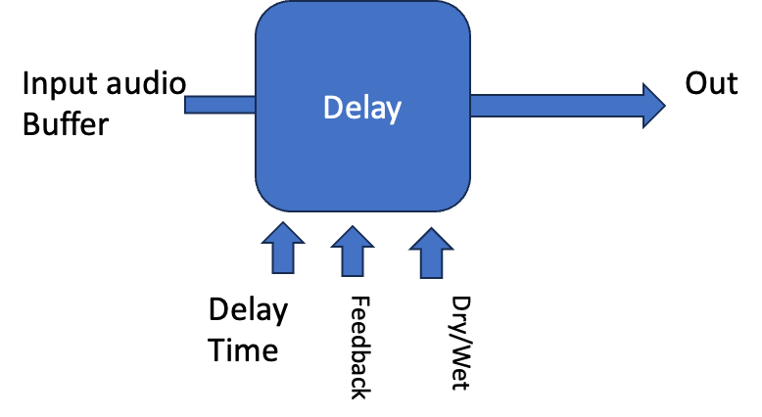
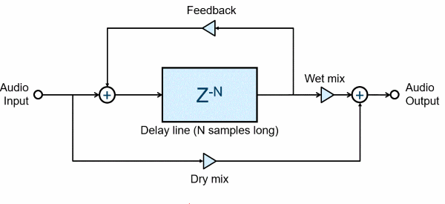
Delay

Slide 12
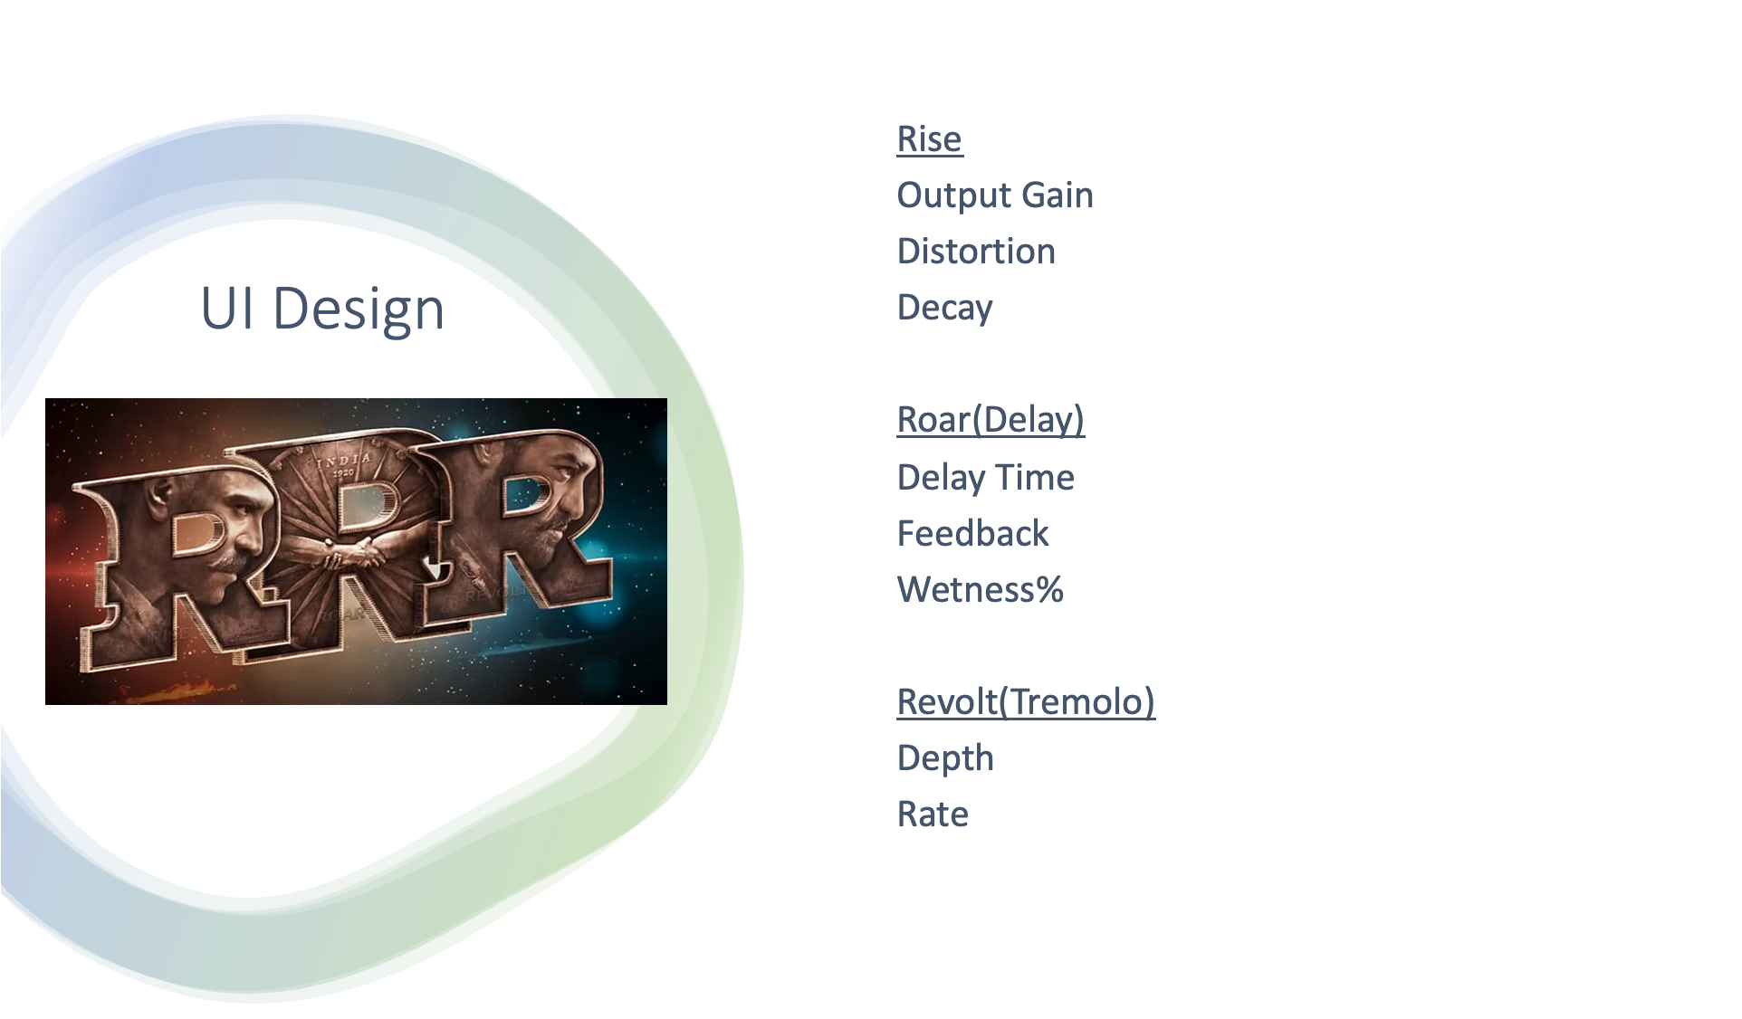

Slide 13
DEMO

Slide 14
Participant Study:
Objective: Determining the effectiveness and the user experience of our audio plugin in a real world context, by asking the participants to create a melody using our plugin.
Participants: Choosing 3 participants who have some level of interaction with audio plugins, ensuring they represent a diverse range of experience and preferences in the audio world in general.
Ethical considerations: Taking consent of all 3 participants to record their video and take their opinions and using them for the presentation and for the final project, by explaining them the purpose of the study, and how their data will be used.
Maintaining anonymity: While conducting the participant study, anonymity of the participants will be ensured.

Slide 15
Participant Study:
4. Data Collection Methods:
Observational:
Recording a video of the participants while they interact with the plugin.
Noting down the plugin elements they interact with.
Noting down how much the user explores and tries to be creative with the plugin.
Noting down how easily the user achieves what their desired melody is.
Encouraging the user to think aloud during their interaction to capture their thoughts in real time.
Quantitative:
Overall time taken to interact with the plugin.
Time taken to achieve the desired outcome.
Count how many plugin elements were used.
Count number of times a similar plugin element was used.
Range of plugin element used.

Slide 16
Participant Study:
Qualitative: Through a google form, ask the user questions like:
Overall satisfaction with the experience of using the plugin.
Their opinion on the quality of effects.
Their opinion of effectiveness of the different components in the plugin.
Their opinion on how easy was it to create a melody that they wanted to create.
Features of the plugin they liked and disliked.
Suggestions on how to change the effects of the plugin to suit their preferences.
Ask if they faced any major issues.
5. Integration and analysis of data: Take all the collected data into consideration and take relevant inferences from the collected data.
6. Reflection and Limitations: Reflect on the study’s limitations such as small sample size and potential biases. Get ideas for further development of the plugin.
Guitarizzz

Slide 17
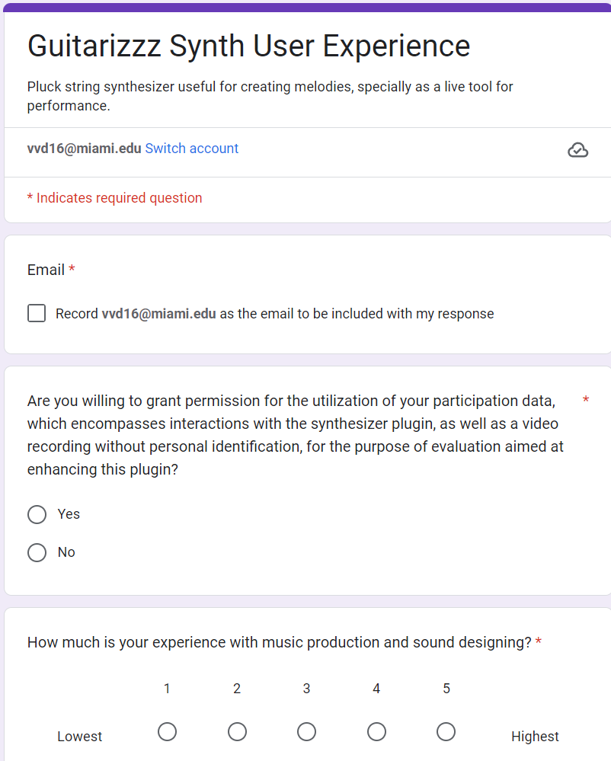
Participant Study:
Google form

Slide 18
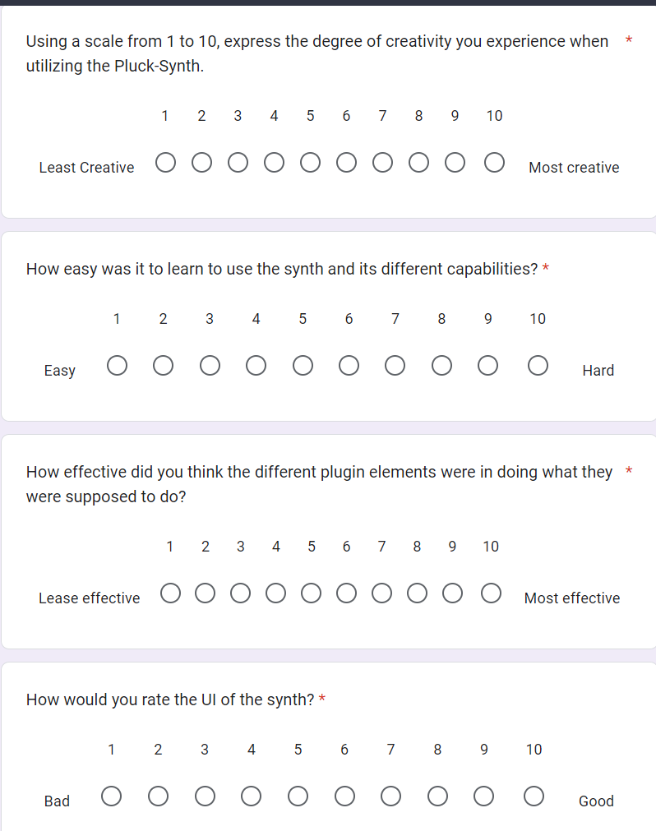
Participant Study:
Google form

Slide 19
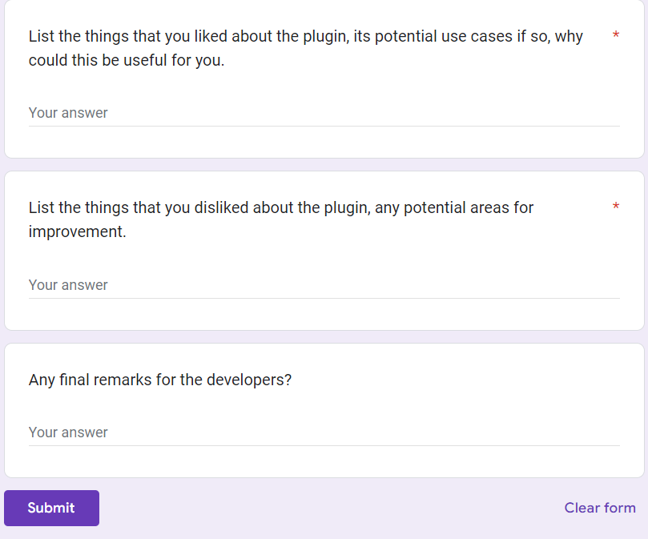
Participant Study:
Google form

Slide 20
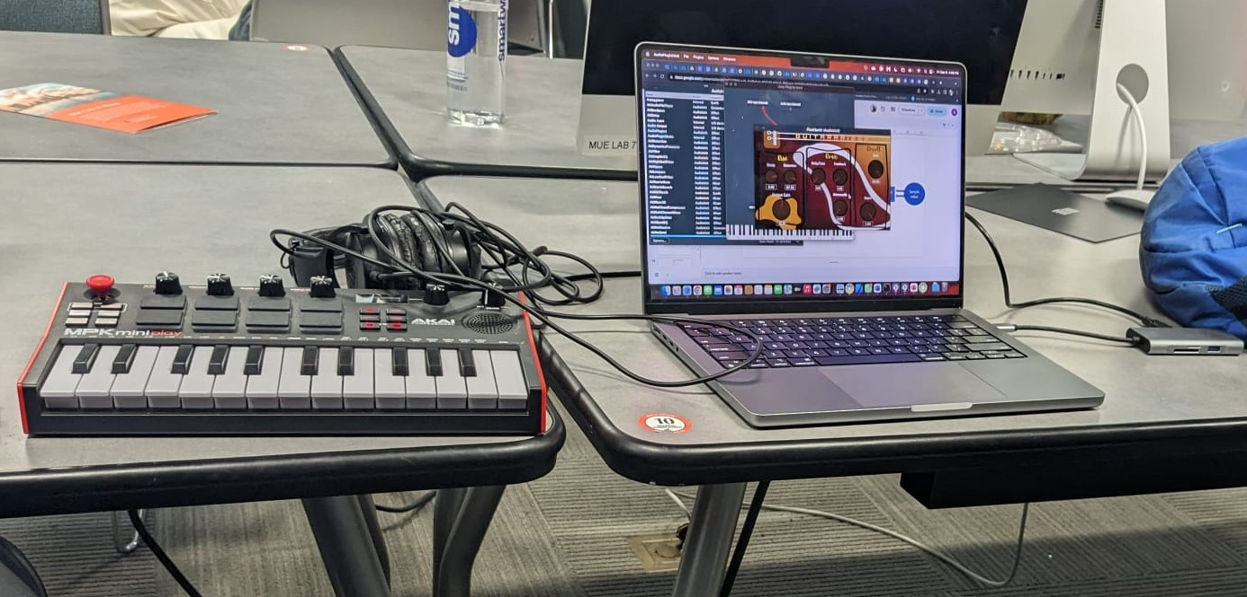
Some Highlights of participants testing the plugin:
Basic setup for testing the plugin.

Slide 21
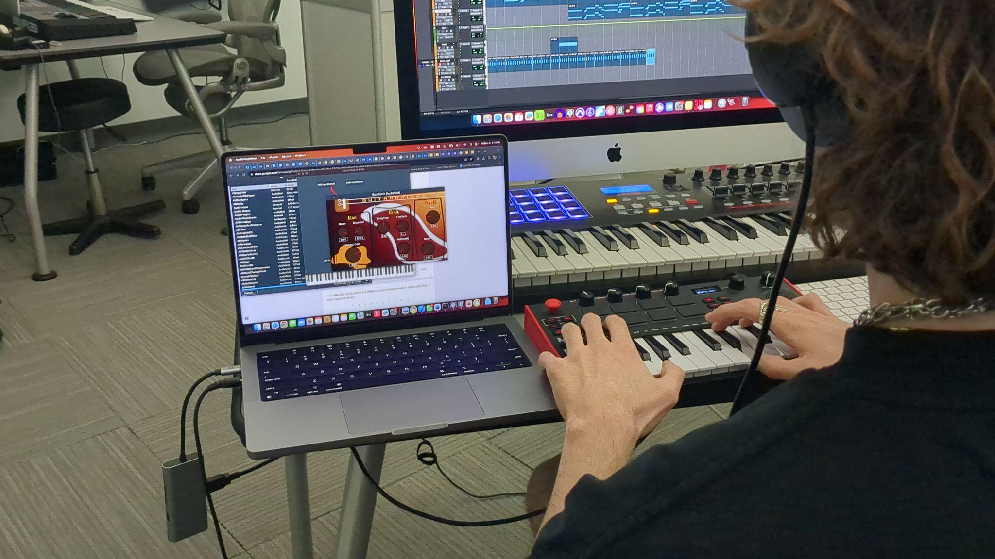
Some Highlights of participants testing the plugin:
One of the participants testing out the plugin

Slide 22
Findings from the study:
Quantitative
All users found the plugin element to be very effective, and the elements did what they were supposed to do (87%).
Users felt they could be really creative with the plugin (80%).
The UI was really liked by the users (83%)
The learnability of the plugin was poor (30%).
The users struggled to achieve a desired sound from the plugin (23%).

Slide 23
Findings from the study:
Observational and Qualitative
Effect name was a bit confusing, for one user, preferred something simpler.
Users suggested more effects to be added to the plugin.
On an average the users took around 45-50 seconds to create a sound of their liking from the plugin.
All users really liked the overall sound of the plugin.
All users really wanted to experiment with the plugin.

Slide 24
Where we can use this plugin?
Music production : Electronic music and rock music
Sound Design and use to emulate a particular guitar tone that you want
Live performance
Why should you Use this plugin?
This plugin gives you the freedom of designing the kind of guitar sounds according to your application.

Slide 25

Thank You

